Slide 1
Never Alone: Toward an Equitable Response to the Ongoing Opioid Crisis During the Perinatal Period
Kyle Mounts
Wisconsin Association for Perinatal Care

Slide 2
Accreditation: CME
This activity has been planned and implemented in accordance with the accreditation requirements and policies of the Accreditation Council for Continuing Medical Education (ACCME) through the joint providership of the Wisconsin Association for Perinatal Care (WAPC) and the Center for Urban Population Health (CUPH).
The Wisconsin Association for Perinatal Care (WAPC) is accredited by the Wisconsin Medical Society to provide continuing medical education for physicians.
The Wisconsin Association for Perinatal Care (WAPC) designates this internet live course for a maximum of 1 AMA PRA Category 1 CreditTM. Physicians should claim only the credit commensurate with the extent of their participation in the activity.
To receive credit, participants must attend the entire activity.

Slide 3
Disclosures: Planners/Faculty
Lonnetta Albright
Elizabeth Duthie
David Frazer
Bernestine Jeffers
Cora Knight
Kyle Mounts
Carrie Stehman
Georgiana Wilton
No one in control of content has any relevant financial relationships with ineligible companies.*
*Ineligible companies are those whose primary business is producing, marketing, selling, reselling, or distributing healthcare products used by or on patients.

Slide 4
Objectives
Describe the significance of the fourth trimester.
Explain the APHA policy.
Describe two potential strategies to support equitable care of birthing persons with a substance use disorder in the postpartum period.

Slide 5
Outline
The fourth trimester
An Equitable Response to the Ongoing Opioid Crisis
Equitable care during the postpartum period for birthing persons with a substance use disorder

Slide 6
The Fourth Trimester

Slide 7
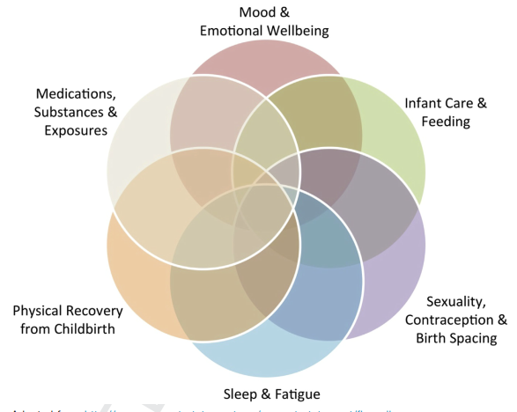
Tully et al., 2017

Slide 8
American College of Obstetricians and Gynecologists
ACOG Committee Opinion 736 (May 2018)
Birthing persons
Adapt to multiple physical, social, and psychological changes
Navigate preexisting health and social issues
In an environment characterized by
Fragmented postpartum care
Inconsistent communication
Lack of support

Slide 9
ACOG Recommendations
Postpartum care should be an ongoing process
Postpartum visit ideally within 3 weeks of delivery
Comprehensive visit no later than 12 weeks after delivery with full assessment of physical, social, and psychological well-being
Counseled on higher lifetime risk of cardiometabolic disease associated with preterm birth, gestational diabetes, or hypertensive disorders of pregnancy
Counseled on timely follow-up for chronic medical conditions
Policy changes required to optimize care and support for birthing persons and families

Slide 10
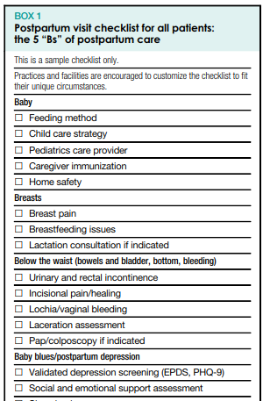
Society for Maternal-Fetal Medicine
Special Statement (October 2022)
5 “Bs” of postpartum care
  Baby
  Breasts
  Below the waist
  Baby blues/postpartum depression
  Birth control/future reproductive plans
Additional considerations
  Pregnancy complications
  Medical conditions

Slide 11

Parikh et al., 2021

Slide 12
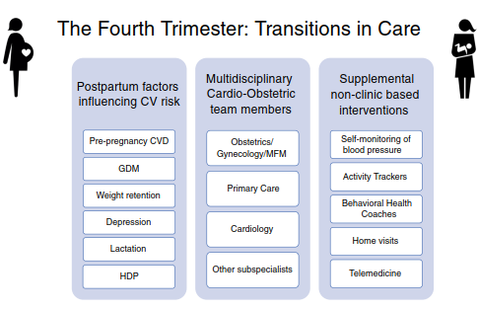
Choi et al., 2022

Slide 13
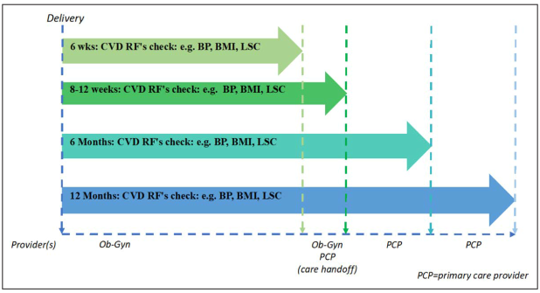
Parikh et al., 2021

Slide 14
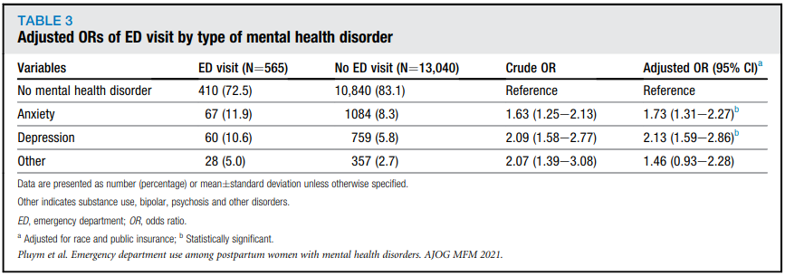
Pluym et al., 2021

Slide 15
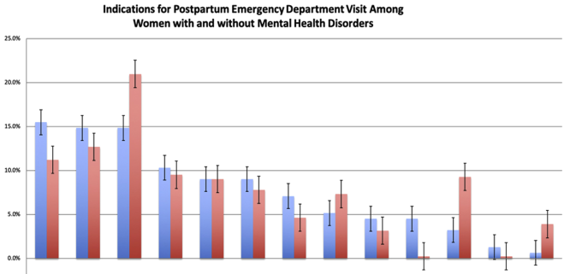
Wound
MHD
No MHD
HTN
Pain
Psych
Pluym et al., 2021

Slide 16
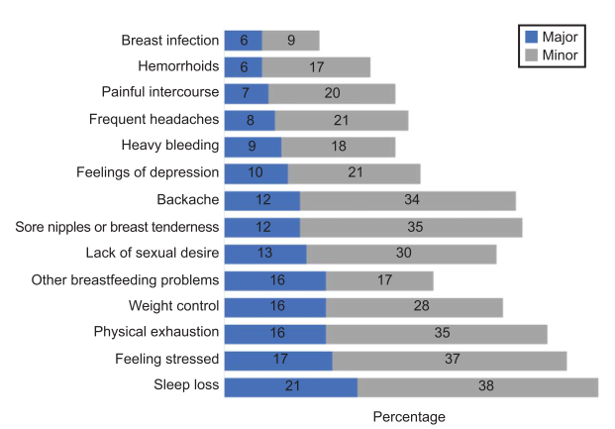
Stuebe et al., 2021

Slide 17
Consensus Bundle on Postpartum Care Basics: From Birth to the Comprehensive Postpartum Visit
Postpartum care plan that includes a medical home
Postpartum care team, including friends and family, to provide medical, material, and social support
Systems to connect families with community resources
Protocols for screening and treatment for postpartum concerns, including depression and SUDs
Guidelines for patient education, discharge, and indications for early postpartum visits
Reimbursement policies that do not disincentivize postpartum visits
Stuebe et al., 2021

Slide 18
Health Equity in Drug Policy & Regulations
“The issue is justice”
Braveman et al., 2011

Slide 19
An Equitable Response to the Ongoing Opioid Crisis
https://www.apha.org/Policies-and-Advocacy/Public-Health-Policy-Statements/Policy-Database/2022/01/07/An-Equitable-Response-to-the-Ongoing-Opioid-Crisis
Update to APHA policy
  Prevention and Intervention Strategies to Decrease Misuse of Prescription Pain Medication

Slide 20
Goal of Updating Existing Opioid Policy
Highlight the disproportionate impact on vulnerable and historically marginalized populations
Incorporate less stigmatizing language and accurately describe current concerns
Address a more dangerous landscape of potent synthetic opioids, polysubstance use, and growth in stimulant overdose deaths (with or without opioid involvement)
Reflect new research on intervention strategies
Mobilize advocacy across APHA

Slide 21
Health Equity Concerns
Disparities in access to treatment – medications are the standard of care for opioid use disorder
Disparities in responses to use and access to overdose prevention
Limited access and understanding of harm/risk reduction services and strategies
Impact of stigma on individuals and communities
Regulatory, reimbursement, training, and infrastructure barriers
Inadequate real time surveillance systems addressing socioeconomic disparities

Slide 22

Evidence-Based Strategies to Protect Public Health
Actions in Four Key Areas:
Protecting vulnerable populations
Minimize individual and community harm
Prioritize equity and social justice to address harms caused to populations disproportionately impacted by prior drug policy approaches
Expand and improve monitoring, surveillance, and data utilization to address inequity and improve access to services and evaluate effectiveness and outcomes

Slide 23
Protect Vulnerable Populations
Enhance and improve tertiary prevention and treatment programs
Address policy and regulatory barriers with special attention to vulnerable and marginalized populations
Education on harm reduction and treatment best practices
Conduct community readiness assessments to improve community and school-based programming
Screening, brief intervention, and referral to treatment (SBIRT)
Encourage interprofessional coalitions.

Slide 24
Minimize Individual & Community Harm
Access to medications for Opioid Use Disorder
Naloxone – the AED of opioid overdose
Fentanyl testing strips
Syringe Service Programs (SSPs)
Safe Consumption Sites
Education to reduce stigma and address misinformation

Slide 25
Prioritize Equity/Social Justice
Medications for OUD are the most effective treatment
  Reduce overdose mortality
  Access to treatment medications remains limited
  Stigma and fear of DEA action impact provider uptake
Engage policy makers and the medical community to implement opioid treatment and overdose prevention equitably
Workforce training to minimize provider bias
Prioritize access to OUD treatment in criminal justice settings

Slide 26
Surveillance and Monitoring
Ensure systems can provide real time data so public health professionals and policy makers can act promptly to address needs
Ensure that data can be stratified to assess the impact of the opioid epidemic and effectiveness of interventions for vulnerable populations
Improve PDMP functionality to increase utility and build appropriate primary prevention and intervention capacity (assurance vs. enforcement)
Conduct community readiness assessments to improve community and school-based programming (building effective local safety networks)
Evaluate cost effectiveness of interventions

Slide 27
Addressing the Ongoing Crisis – a few examples
Exploring the application of intersectionality as a path toward equity (Hoang and Wong, 2023)
Utilizing inter-generational approaches and leveraging multidisciplinary teams (Gopalan et al., 2022)
Promoting health and social equity through family navigation (Waid et al., 2022)
Comprehensive community engagement in a health equity-oriented research agenda (Rice et al., 2022)

Slide 28
Fourth Trimester Care for Birthing Persons with a Substance Use Disorder

Slide 29
North Carolina
The best outcomes for the birthing person create the best outcomes for the pregnancy and children; the best outcome for infants and older children is to have a parent in recovery, with the parenting skills to care for them.
SUD requires ongoing, whole-health management for lasting recovery.

Slide 30
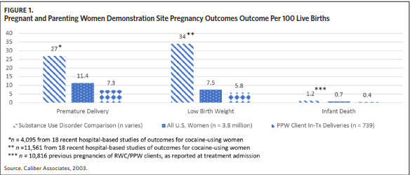
Godwin et al., 2020

Slide 31
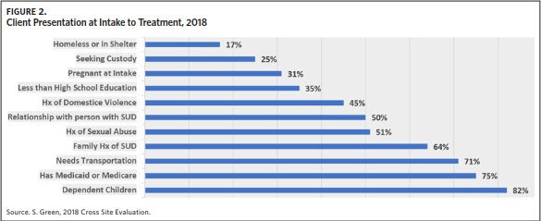
Godwin et al., 2020

Slide 32
Social Support
Lubker Cornish and Roberts Dobie (2018)
Qualitative study exploring how postpartum persons experience social support
  22 participants
  Semistructured interviews at approximately 1 and 3 months
Types of support
  Instrumental support
  Emotional support
  Informational support

Slide 33
Key Areas
Protecting vulnerable populations
Minimize individual and community harm
Prioritize equity and social justice to address harms caused to populations disproportionately impacted by prior drug policy approaches
Expand and improve monitoring, surveillance, and data utilization to address inequity and improve access to services and evaluate effectiveness and outcomes

Slide 34
Let’s work together.

Slide 35
Thank you
mounts@wiperinatal.web

