Slide 1
Connecting the Dots: Overdose in Pregnancy and the Relationships with Family
November 10, 2023

Slide 2
Accreditation: CME
This activity has been planned and implemented in accordance with the accreditation requirements and policies of the Accreditation Council for Continuing Medical Education (ACCME) through the joint providership of the Wisconsin Association for Perinatal Care (WAPC) and the Center for Urban Population Health (CUPH).
The Wisconsin Association for Perinatal Care (WAPC) is accredited by the Wisconsin Medical Society to provide continuing medical education for physicians.
The Wisconsin Association for Perinatal Care (WAPC) designates this internet live course for a maximum of 1 AMA PRA Category 1 CreditTM. Physicians should claim only the credit commensurate with the extent of their participation in the activity.
To receive credit, participants must attend the entire activity and complete the evaluation.

Slide 3
Disclosures: Planners/Faculty
Lonnetta Albright
Elizabeth Duthie
David Frazer
Bernestine Jeffers
Cora Knight
Kyle Mounts
Carrie Stehman
Georgiana Wilton
No one in control of content has any relevant financial relationships with ineligible companies.*
*Ineligible companies are those whose primary business is producing, marketing, selling, reselling, or distributing healthcare products used by or on patients.

Slide 4
Objectives
At the conclusion of the program, participants will be able to:
Describe trends in overdose during pregnancy;
Describe two ways family system challenges impact opioid overdose;
Describe two ways overdose impacts families.

Slide 5
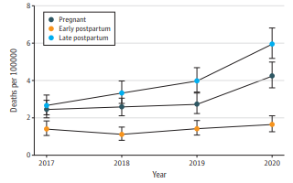
Pregnancy-Associated Drug Overdose Mortality, Timing
Bruzelius and Martins, 2022

Slide 6
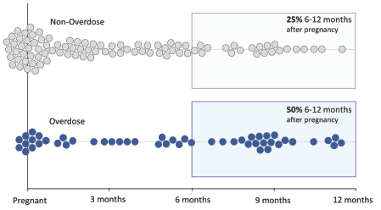
Pregnancy Timing
Prevention Research Center and WI DHS, 2021

Slide 7
Pregnancy-Related
A death during pregnancy or within one year of the end of pregnancy from a pregnancy complication, a chain of events initiated by pregnancy, or the aggravation of an unrelated condition by the physiologic effects of pregnancy. In addition to having a temporal relationship to pregnancy, these deaths are causally related to pregnancy or its management.
Trost et al., 2022

Slide 8
Characteristics of Pregnancy-Related Deaths, 2017-2019 (N = 1018)
Race/Ethnicity | N (Deaths) | % Deaths
Hispanic | 144 | 14.4
NH AI/AN | 9 | 0.9
NH Asian | 34 | 3.4
NH Black | 315 | 31.4
NH NH/OPI | 6 | 0.6
NH White | 467 | 46.6
NH Other/Multiple | 27 | 2.7
Trost et al., 2022

Slide 9
Characteristics of Pregnancy-Related Deaths
Race/Ethnicity | % Deaths | % Population (2019) | Difference
Hispanic | 14.4 | 18.5 | 4.1
NH AI/AN | 0.9 | 0.7 | -0.2
NH Asian | 3.4 | 5.8 | 2.4
NH Black | 31.4 | 12.5 | -18.9
NH NH/OPI | 0.6 | 0.2 | -0.4
NH White | 46.6 | 60.1 | 13.5
NH Other/Multiple | 2.7 | 2.2 | -0.5
Trost et al., 2022; US Census

Slide 10
Underlying Causes of Pregnancy-Related Deaths | Percent
Mental health conditions* | 22.7
Hemorrhage | 13.7
Cardiac and coronary conditions | 12.8
Infection | 9.2
Thrombotic embolism | 8.7
Cardiomyopathy | 8.5
Hypertensive disorders of pregnancy | 6.5
Amniotic fluid embolism | 3.8
*Mental health conditions include deaths by suicide, overdose/poisoning related to SUD, and other deaths determined by the MMRC to be related to a mental health condition, including SUD.
Trost et al., 2022

Slide 11
Mental Health Conditions: Pregnancy-Related Deaths
Mental Health Conditions | N | % | Population %
TOTAL | 224 | 22.7
Hispanic | 34 | 24.1 | 18.5
NH AI/AN | 2 | - | 0.7
NH Asian | 1 | 3.1 | 5.8
NH Black | 21 | 7.0 | 12.5
NH NH/OPI | 0 | - | 0.2
NH White | 159 | 34.8 | 60.1
Mental health conditions include deaths by suicide, overdose/poisoning related to SUD, and other deaths determined by the MMRC to be related to a mental health condition, including SUD.
Trost et al., 2022

Slide 12
Pregnant People with SUD Need Treatment
Drug overdose deaths increased by 81% between 2017 and 2020.
Quality addiction treatment is lacking, especially in rural areas and for some racial and ethnic groups.
There can be barriers, including transportation, housing, food, other necessities.
Very few treatment facilities provide child care.
Fear of criminal punishment deters many pregnant people from seeking help for drug or alcohol problems.
Volkow, 2023

Slide 13
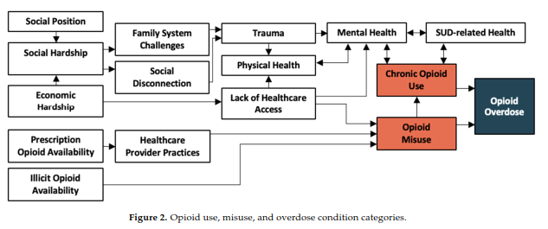
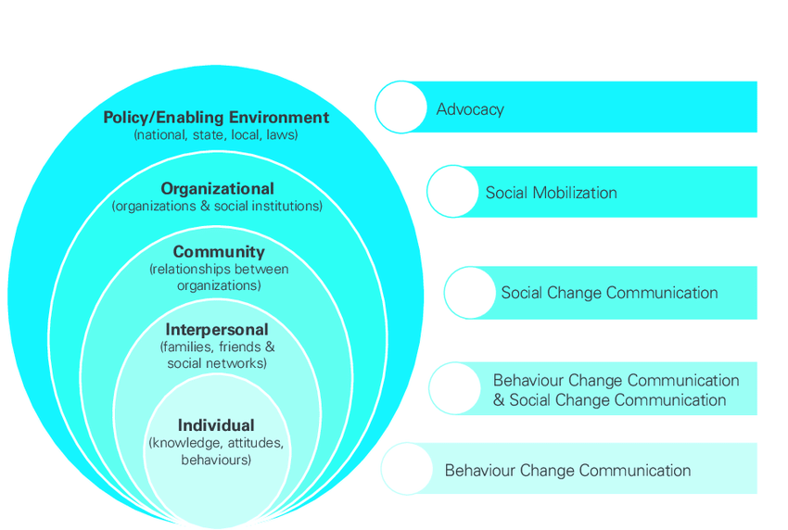
Opioid use, misuse, and overdose condition categories
Brady et al., 2023; van der Straaten et al., 2013

Slide 14
Opioid use, misuse, and overdose condition categories
Brady et al., 2023

Slide 15
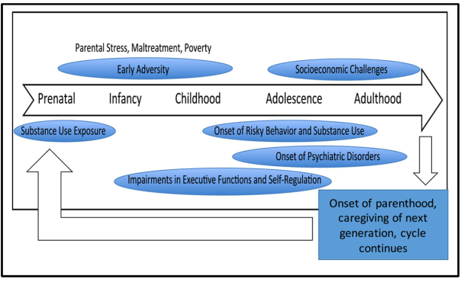
Rutherford and Mayes, 2017

Slide 16
Fatal Overdose
Reports on childhood outcomes after parental death due to overdose
Insufficient data
Reports on childhood outcomes after parental death are inconclusive
Psychiatric risk
School success

Slide 17
Fatal Overdose
Hulsey et al., 2020

Slide 18
Predictors of stigma, guilt, and shame among adults bereaved by fatal overdose
Pre-death factors associated with stigmatization, guilt, and shame after a fatal overdose
Frequency of decedent’s drug use
Family drug use severity
Interpersonal conflict between bereaved and decedent
Bottomley et al., 2023

Slide 19
Life after opioid-involved overdose: survivor narratives
Motivators for change
Fear
Social relationships
Barriers to change
Shame
Despair
Managing withdrawal without assistance
Elliott et al., 2019

Slide 20
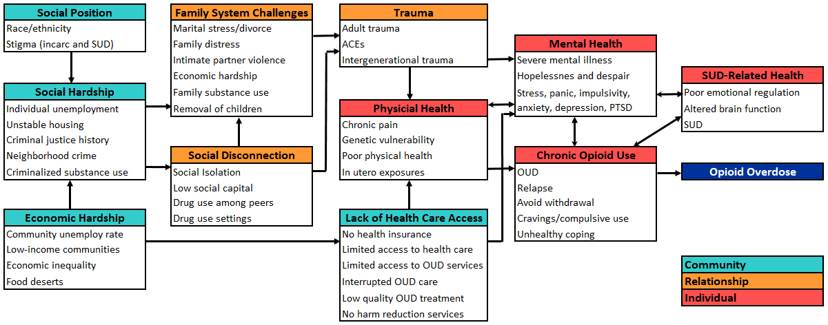
Opioid use, misuse, and overdose condition categories
Brady et al., 2023

Slide 21
Thank you
mounts@wiperinatal.web

